Slide 1

Structured Query Language - II
Gerry Guinane
Limerick Institute of Technology
SQL Lecture 02

Slide 2
Learning outcomes
Learning outcomes – the student will be able to
Use the following SQL syntax – SELECT INTO
Use the SQL Inner Join table expression.

Slide 3
Table Joins

Slide 4
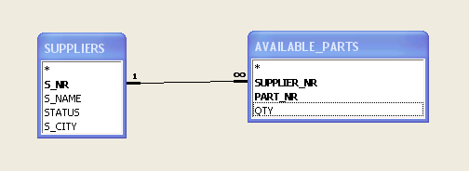
Table Expression – Inner Join
These 2 tables share common values in the Supplier Number

Slide 5
Table Expression – Inner Join
AVAILABLE_PARTS
SUPPLIERS
SUPPLIER_NR | PART_NR | QTY
S1 | P1 | 300
S1 | P2 | 200
S1 | P3 | 400
S1 | P4 | 200
S1 | P5 | 100
S1 | P6 | 100
S2 | P1 | 300
S2 | P2 | 600
S4 | P2 | 200
S4 | P4 | 300
S4 | P5 | 400
S_NR | S_NAME | STATUS | S_CITY
S1 | SMITH | 45 | DUBLIN
S2 | JONES | 10 | PARIS
S3 | BLAKE | 30 | PARIS
S4 | CLARK | 45 | DUBLIN
S5 | ADAMS | 30 | ATHENS
These 2 tables share common values in the Supplier Number

Slide 6
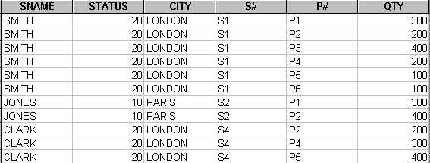
Expression:InnerJoin
An Innerjoin will join the two tables bases on common values. Only records where common values exist will form part of the query result – thus no S5 entry.

Slide 7
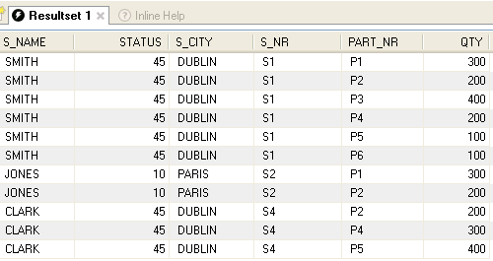
Table Expression - InnerJoin
SELECT
SUPPLIERS.S_NAME,
SUPPLIERS.STATUS,
SUPPLIERS.S_CITY,
SUPPLIERS.S_NR,
AVAILABLE_PARTS.PART_NR,
AVAILABLE_PARTS.QTY
FROM
SUPPLIERS
INNER JOIN
AVAILABLE_PARTS
ON
SUPPLIERS.S_NR=AVAILABLE_PARTS.SUPPLIER_NR;

Slide 8
Types of Joins
Other Joins...
join_table:
table_reference [INNER | CROSS] JOIN table_factor [join_condition]
table_reference STRAIGHT_JOIN table_factor |
table_reference STRAIGHT_JOIN table_factor ON condition
table_reference LEFT [OUTER] JOIN table_reference join_condition
table_reference NATURAL [LEFT [OUTER]] JOIN table_factor
table_reference RIGHT [OUTER] JOIN table_reference join_condition
table_reference NATURAL [RIGHT [OUTER]] JOIN table_factor

Slide 9
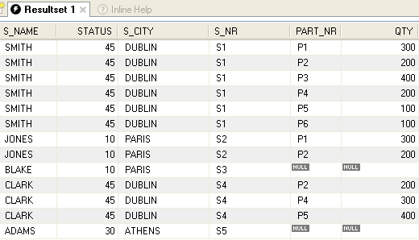
Table Expression - LeftJoin
SELECT
SUPPLIERS.S_NAME,
SUPPLIERS.STATUS,
SUPPLIERS.S_CITY,
SUPPLIERS.S_NR,
AVAILABLE_PARTS.PART_NR,
AVAILABLE_PARTS.QTY
FROM
SUPPLIERS
LEFT JOIN
AVAILABLE_PARTS
ON
SUPPLIERS.S_NR=AVAILABLE_PARTS.SUPPLIER_NR;

Slide 10
Syntax (MySQL)
SELECT [predicate]
select_expr, ...
[FROM table_references
[WHERE where_condition]
[GROUP BY {col_name | expr | position}
[ASC | DESC], ... [WITH ROLLUP]]
[HAVING where_condition]
[ORDER BY {col_name | expr | position}
[ASC | DESC], ...]
[LIMIT {[offset,] row_count | row_count OFFSET offset}]
[PROCEDURE procedure_name(argument_list)]
[INTO OUTFILE 'file_name' export_options
| INTO DUMPFILE 'file_name'
| INTO var_name [, var_name]]
[FOR UPDATE | LOCK IN SHARE MODE]]
☺
Notes:
SELECT
[ALL | DISTINCT | DISTINCTROW ]
[HIGH_PRIORITY]
[STRAIGHT_JOIN]
[SQL_SMALL_RESULT] [SQL_BIG_RESULT] [SQL_BUFFER_RESULT]
[SQL_CACHE | SQL_NO_CACHE] [SQL_CALC_FOUND_ROWS]
select_expr, ...
[FROM table_references
[WHERE where_condition]
[GROUP BY {col_name | expr | position}
[ASC | DESC], ... [WITH ROLLUP]]
[HAVING where_condition]
[ORDER BY {col_name | expr | position}
[ASC | DESC], ...]
[LIMIT {[offset,] row_count | row_count OFFSET offset}]
[PROCEDURE procedure_name(argument_list)]
[INTO OUTFILE 'file_name' export_options
| INTO DUMPFILE 'file_name'
| INTO var_name [, var_name]]
[FOR UPDATE | LOCK IN SHARE MODE]]

Slide 11

SELECT INTO Example
Query
Result
SELECT
SUPPLIERS.S_NR,
SUPPLIERS.S_NAME,
SUPPLIERS.STATUS,
SUPPLIERS.S_CITY
INTO OUTFILE 'C:/result.txt'
FIELDS TERMINATED BY ',' OPTIONALLY ENCLOSED BY '"'
LINES TERMINATED BY '\n'
FROM
SUPPLIERS
WHERE
(((SUPPLIERS.STATUS)>=30));
Result.txt
Notes
This SQL statement creates a new FILE “result.txt”

Slide 12
SELECT INTO – Useful Tip
SELECT
SUPPLIERS.S_NR,
SUPPLIERS.S_NAME,
SUPPLIERS.STATUS,
SUPPLIERS.S_CITY
FROM
SUPPLIERS
WHERE
(((SUPPLIERS.STATUS)>=30));
1st make the SELECT .. FROM part
Run the query to verify it works
Note: Renaming attributes is not mandatory

Slide 13
SELECT INTO – Useful Tip
SELECT
SUPPLIERS.S_NR,
SUPPLIERS.S_NAME,
SUPPLIERS.STATUS,
SUPPLIERS.S_CITY
INTO OUTFILE 'C:/result.txt'
FIELDS TERMINATED BY ','
OPTIONALLY ENCLOSED BY '"'
LINES TERMINATED BY '\n'
FROM
SUPPLIERS
WHERE
(((SUPPLIERS.STATUS)>=30));
Then insert the INTO clause

Slide 14
Syntax (MySQL)
SELECT [predicate]
select_expr, ...
[FROM table_references
[WHERE where_condition]
[GROUP BY {col_name | expr | position}
[ASC | DESC], ... [WITH ROLLUP]]
[HAVING where_condition]
[ORDER BY {col_name | expr | position}
[ASC | DESC], ...]
[LIMIT {[offset,] row_count | row_count OFFSET offset}]
[PROCEDURE procedure_name(argument_list)]
[INTO OUTFILE 'file_name' export_options
| INTO DUMPFILE 'file_name'
| INTO var_name [, var_name]]
[FOR UPDATE | LOCK IN SHARE MODE]]
☺
Notes:
SELECT
[ALL | DISTINCT | DISTINCTROW ]
[HIGH_PRIORITY]
[STRAIGHT_JOIN]
[SQL_SMALL_RESULT] [SQL_BIG_RESULT] [SQL_BUFFER_RESULT]
[SQL_CACHE | SQL_NO_CACHE] [SQL_CALC_FOUND_ROWS]
select_expr, ...
[FROM table_references
[WHERE where_condition]
[GROUP BY {col_name | expr | position}
[ASC | DESC], ... [WITH ROLLUP]]
[HAVING where_condition]
[ORDER BY {col_name | expr | position}
[ASC | DESC], ...]
[LIMIT {[offset,] row_count | row_count OFFSET offset}]
[PROCEDURE procedure_name(argument_list)]
[INTO OUTFILE 'file_name' export_options
| INTO DUMPFILE 'file_name'
| INTO var_name [, var_name]]
[FOR UPDATE | LOCK IN SHARE MODE]]

Slide 15
Select expression
SELECT [predicate]
select_expr, ...
[FROM table_references
The select expression can be used to perform functions on the data eg to get MAX,MIN, SUM or AVERAGE values.

Slide 16




select_expr
SELECT SUM(QTY)
FROM available_parts;
SELECT AVG(QTY) FROM available_parts;
SELECT AVG(QTY) FROM available_parts;
SELECT SUPPLIER_NR,SUM(QTY) FROM available_parts GROUP BY SUPPLIER_NR;

Slide 17
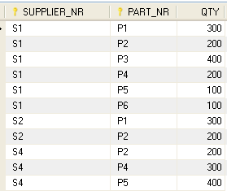
Exercise
1. Based on this table write SQL queries
To select all attributes where QTY is greater than 300 and less than or equal to 100.
To group this query by part nr. P#
2. What is the result of this query:
SELECT ALL AVAILABLE_PARTS.SUPPLIER_,NR AVAILABLE_PARTS.PART_NR, AVAILABLE_PARTS.QTY
FROM AVAILABLE_PARTS
WHERE ((( AVAILABLE_PARTS.QTY)<=300))
ORDER BY AVAILABLE_PARTS.QTY;
3. What is the difference between:
a) SELECT AVAILABLE_PARTS.SUPPLIER_NR, AVAILABLE_PARTS.QTY
FROM AVAILABLE_PARTS
WHERE ((( AVAILABLE_PARTS.SUPPLIER_NR)<>'P1') AND (( AVAILABLE_PARTS.QTY)<400));
b) SELECT AVAILABLE_PARTS.SUPPLIER_NR, AVAILABLE_PARTS.QTY
FROM AVAILABLE_PARTS
WHERE ((( AVAILABLE_PARTS.SUPPLIER_NR)<>'P1') OR (( AVAILABLE_PARTS.QTY)<400));
Table : available_parts
☺

